Slide 1


Join the conversation!
Scan the QR code to be added to the Webex space for Q&A and more

Slide 2
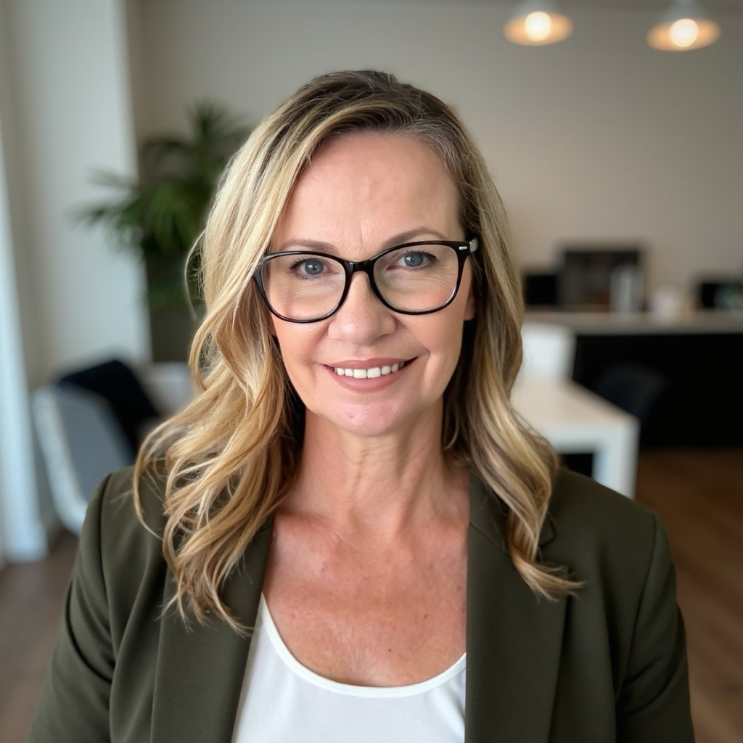
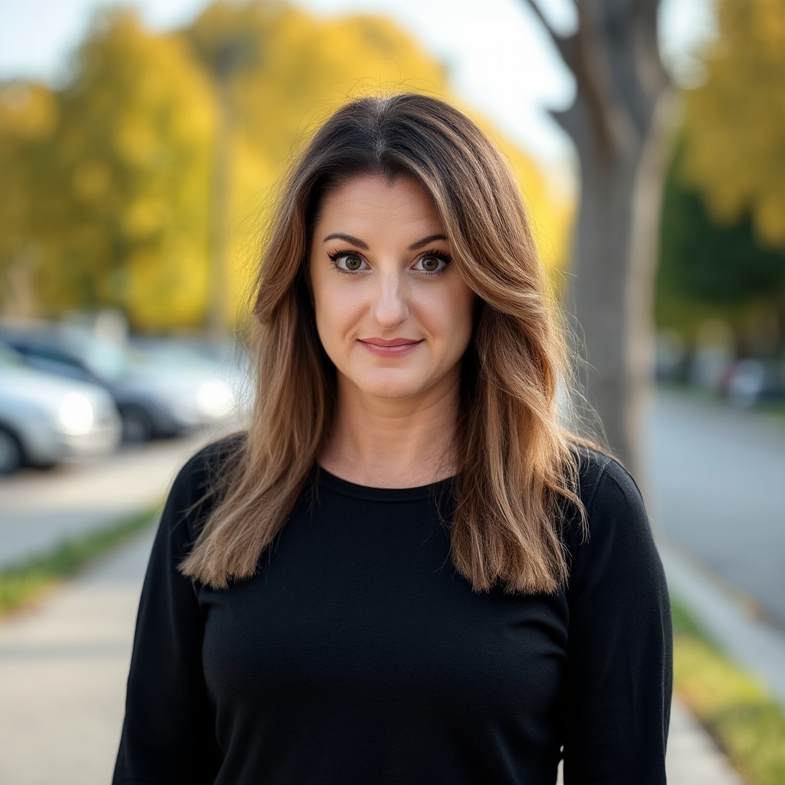
Clare Davis
Susan Parrish
Enablement Specialist, Cisco Systems
Redding, California
Enablement Specialist, Cisco Systems
Raleigh, North Carolina

